Slide 1
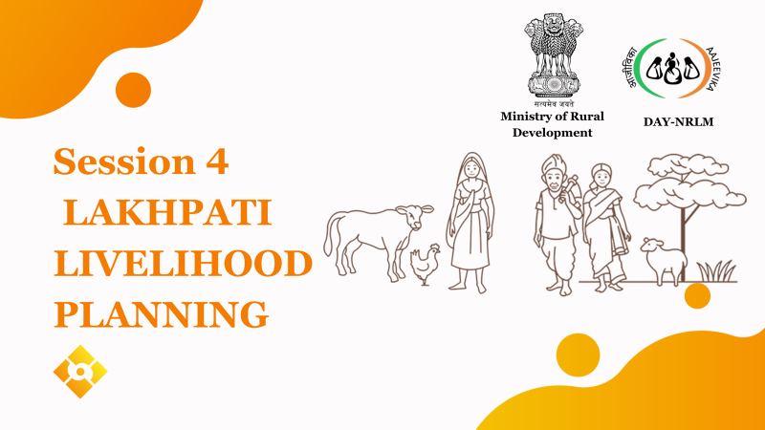
Session -12
Lakhpati Household Livelihood Planning

Slide 2
Day-1

Slide 3
Points for discussions with SHG households
Lakhpati concept(why & what)
Strategy for Lakhpati SHG household livelihood planning
Role play for understanding livelihood planning processes
Demonstration on the livelihood planning template to be filled by household and sharing its hard copy

Slide 4
Lakhpati concept

Slide 5
Mission statement of NRLM
NRLM Mission
“To reduce poverty by enabling the poor households to access gainful self-employment and skilled wage employment opportunities, resulting in an appreciable improvement in their livelihoods on a sustainable basis, through building strong grassroots institutions of the poor.”

Slide 6
Hon’ble Prime Minister on the 77th Independence Day:
(15th August, 2023)
Today 10 crore women are involved in women self-help groups and if you go to a village with women self-help groups, you will find bank didis, Anganwadi didis with and didis who distribute medicines. And now my dream is to create a base of 2 crore lakhpati didis in the villages.

Slide 7
Strategy for livelihoods planning
This Session will cover
Identification of livelihood activities of SHG household, (1)Enhance productivity in different activities by adopting GMP/SoPs or (2)scaling up of existing activities or (3)diversifying into new livelihood activities or a combination thereof.

Slide 8
Group activity on diversification of livelihoods portfolio of SHG household
Role play script:
https://docs.google.com/document/d/16TMfYGKZ3vzyRXJJ9xiGKo0tzLmpbv7b/edit?usp=sharing&ouid=107469613829008637202&rtpof=true&sd=true

Slide 9
Livelihood planning template
https://docs.google.com/spreadsheets/d/12sytH15UkZni43aQvD3J5waHubAG1w-4/edit?usp=sharing&ouid=111221402645274011756&rtpof=true&sd=true

Slide 10
Day-2
One day Orientation of SHG HouseHolds with common activity by the domain experts/exposure visit to existing models

Slide 11
Thank you

